Slide 1
Shopping Website (E- Commerse

Slide 2
Inspirasi pengambilan design
https://dribbble.com/shots/10481389-Amazon-Redesign-Cart-Filters/attachments/2316068?mode=media&fbclid=IwAR1QqlyXWIPvtV1PtTcdBv__YC14sL10cQNCAzw3X6viIJUYPRjOpqQ3YyY

Slide 3
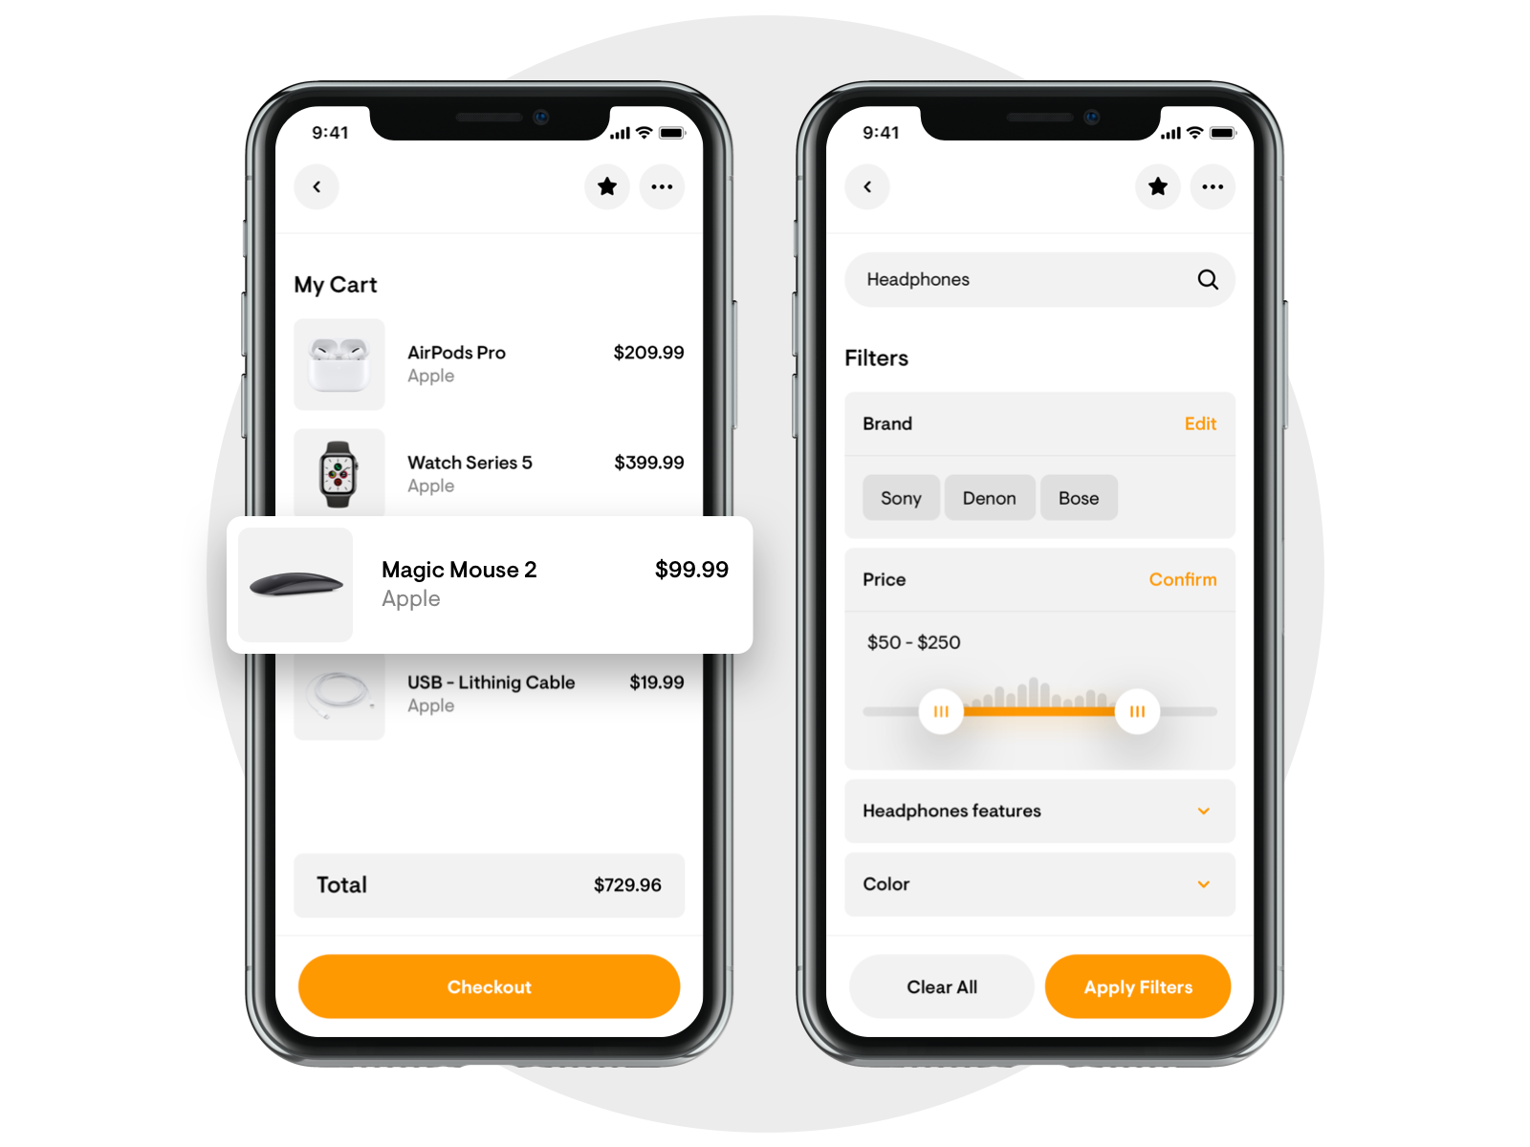
Inspirasi pengambilan design

Slide 4
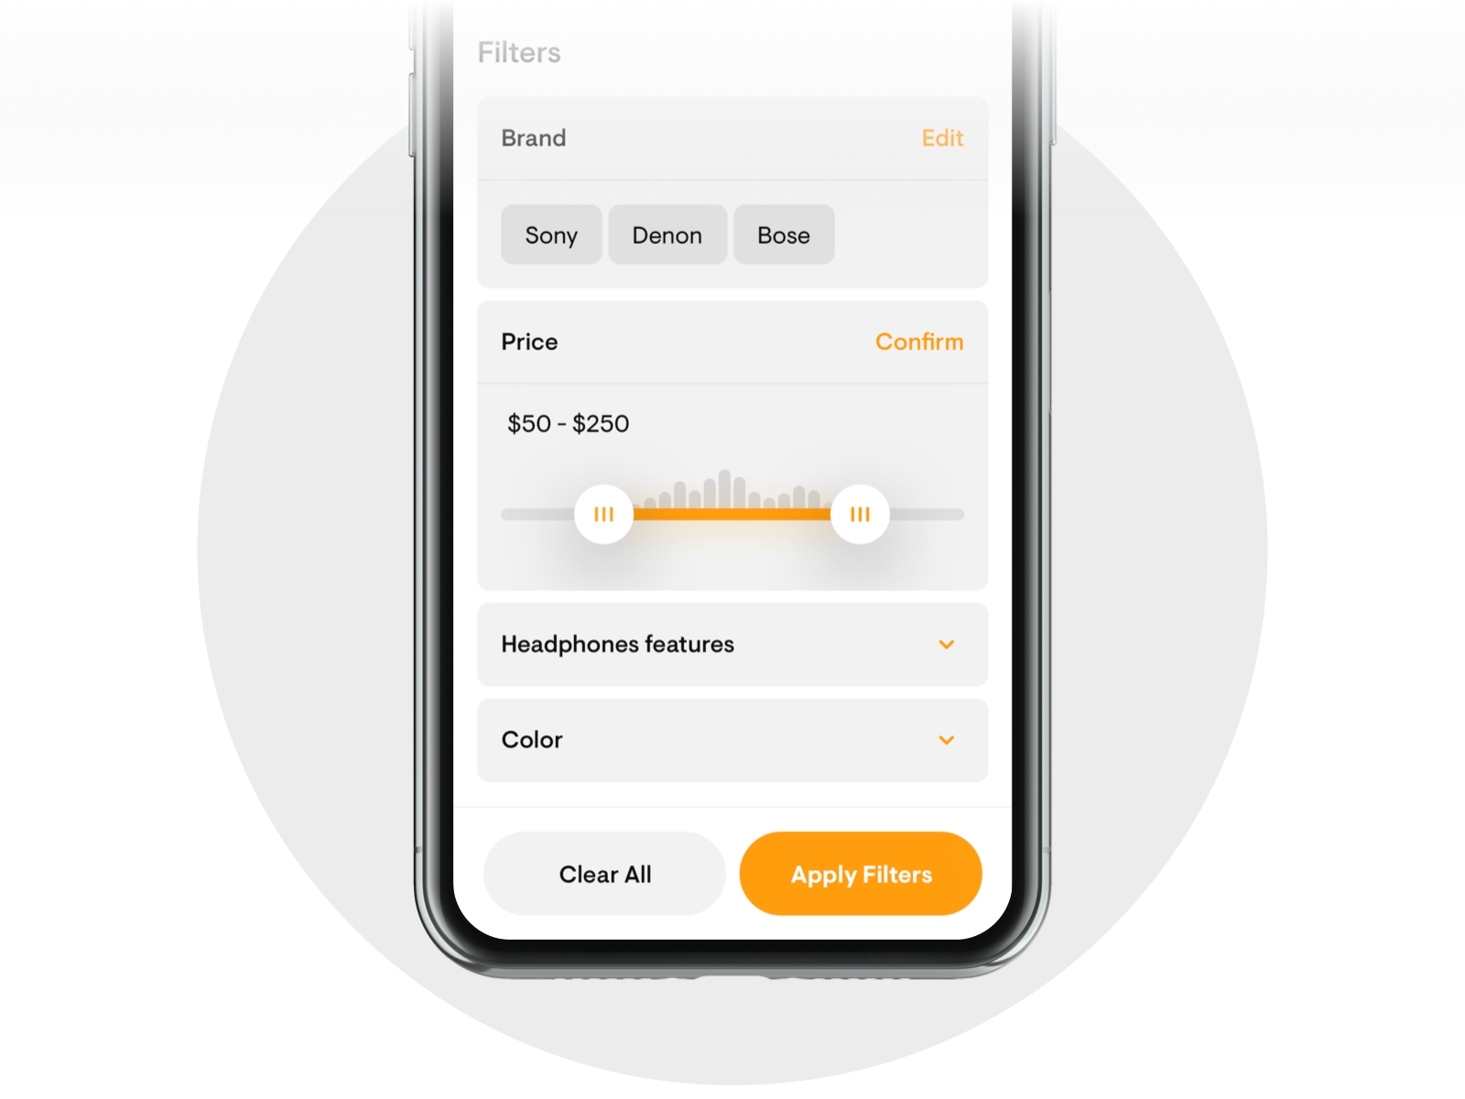
Inspirasi pengambilan design

Slide 5
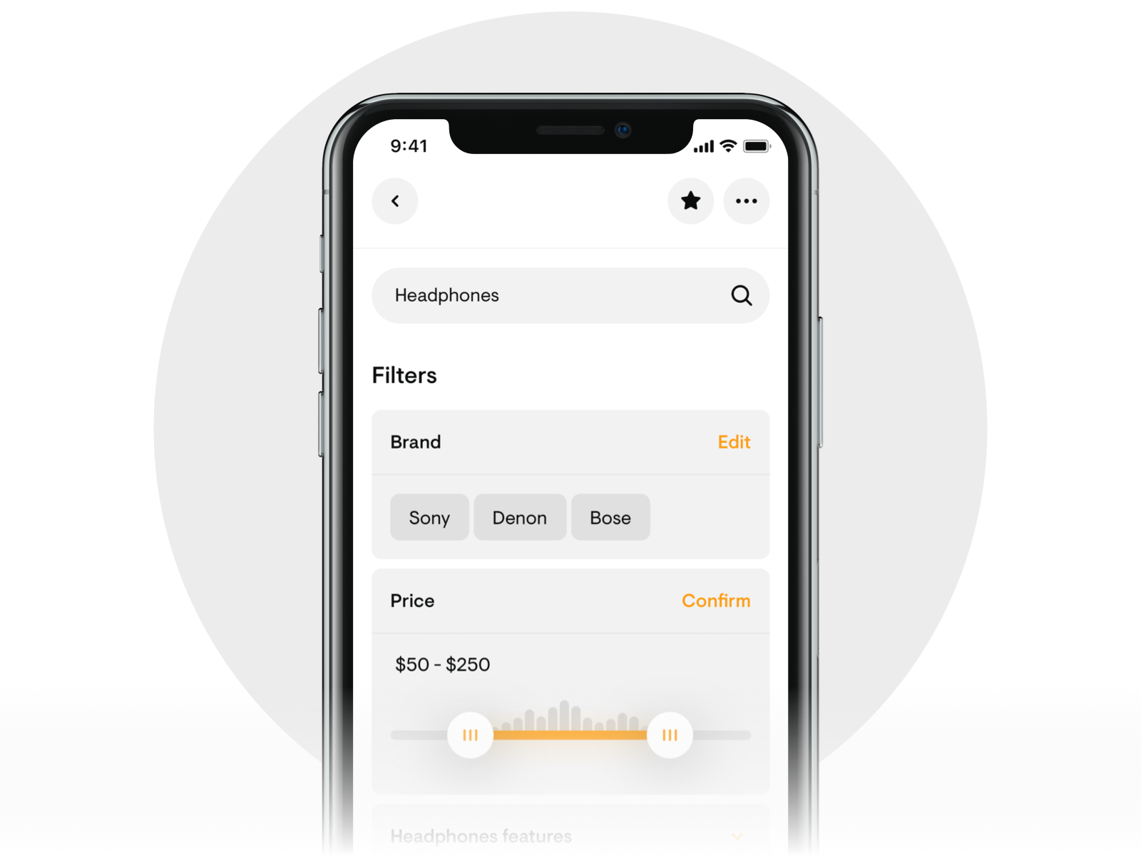
Inspirasi pengambilan design

Slide 6
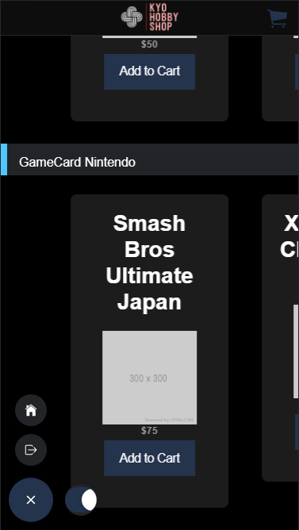
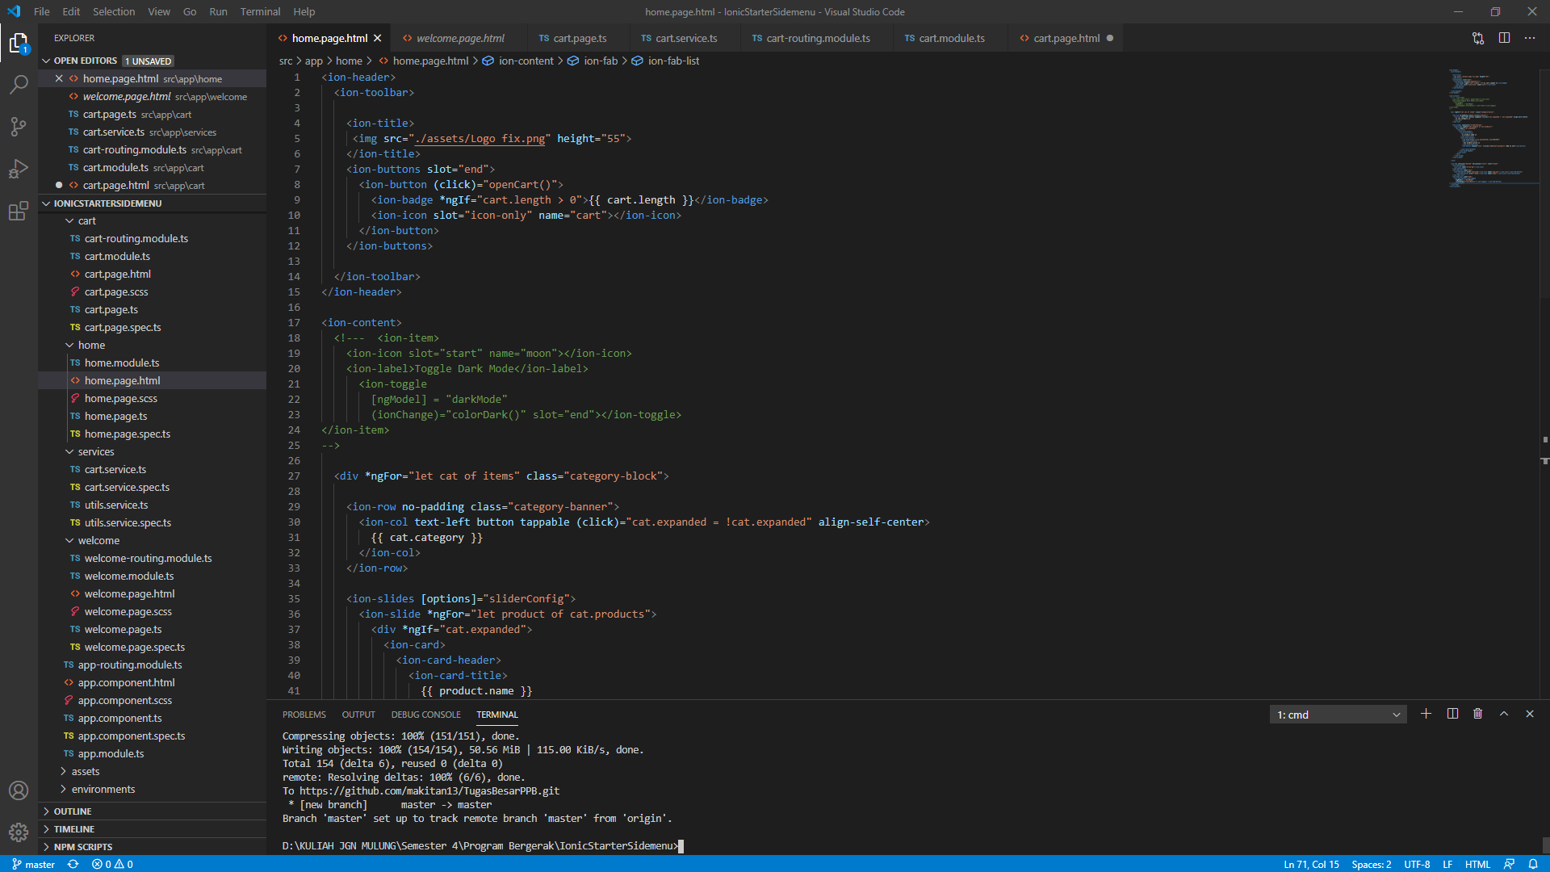
Hasil Implementasi. (Home)

Slide 7

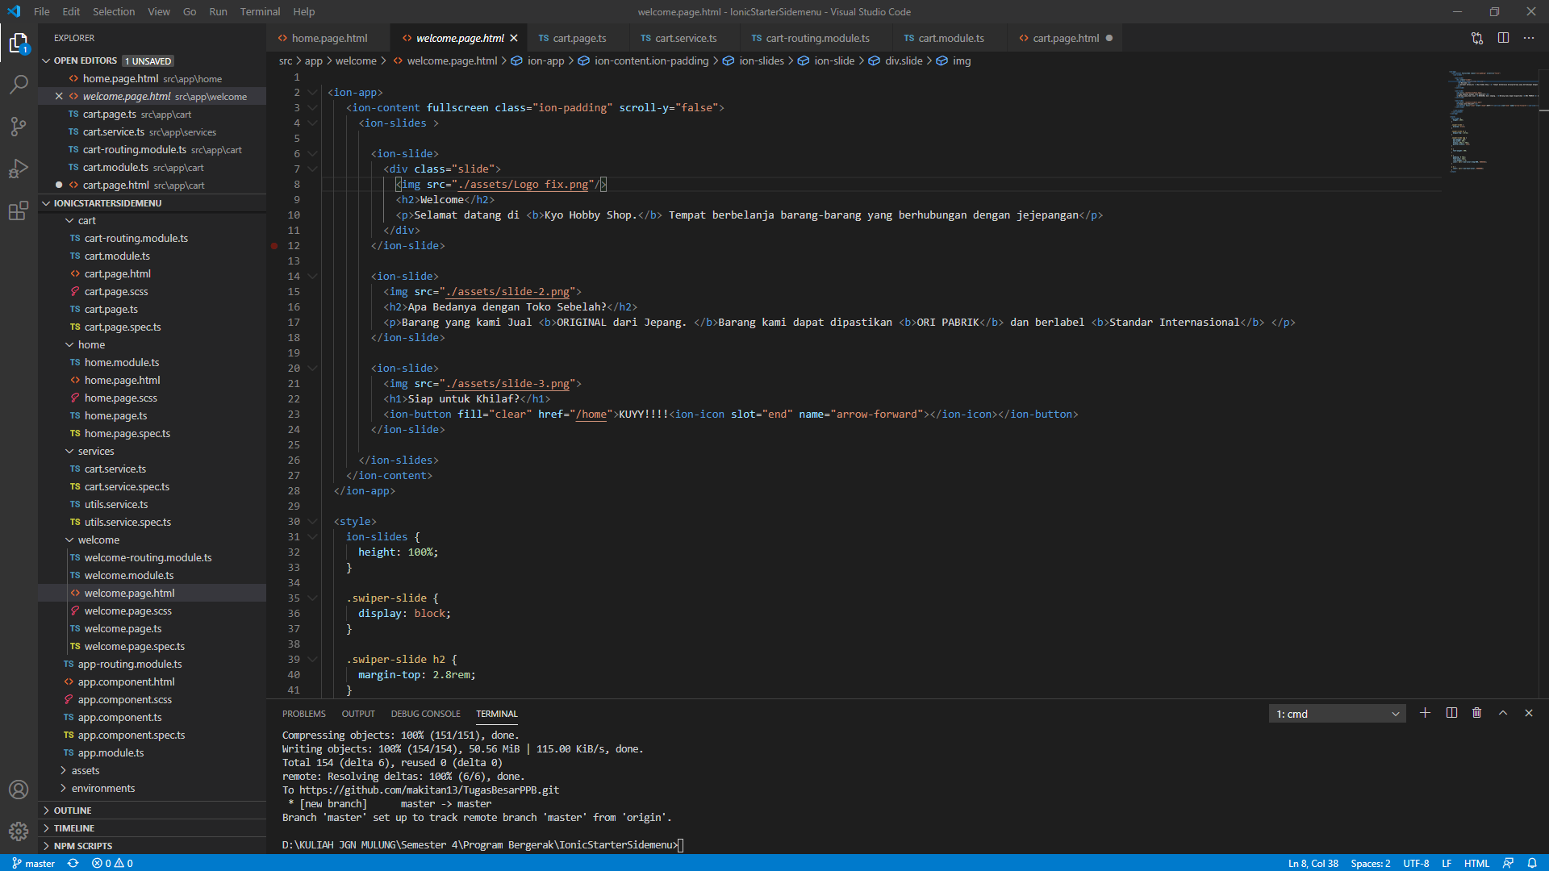
Hasil Implementasi. (Welcome Page)

Slide 8
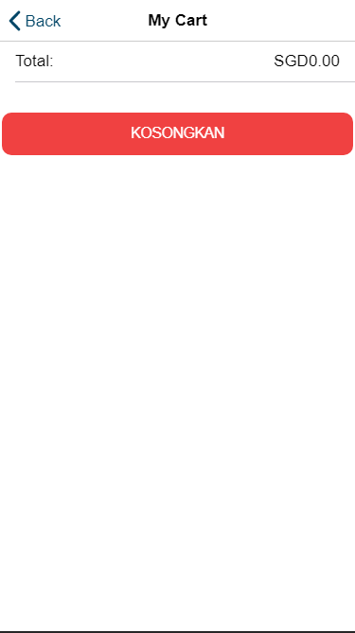
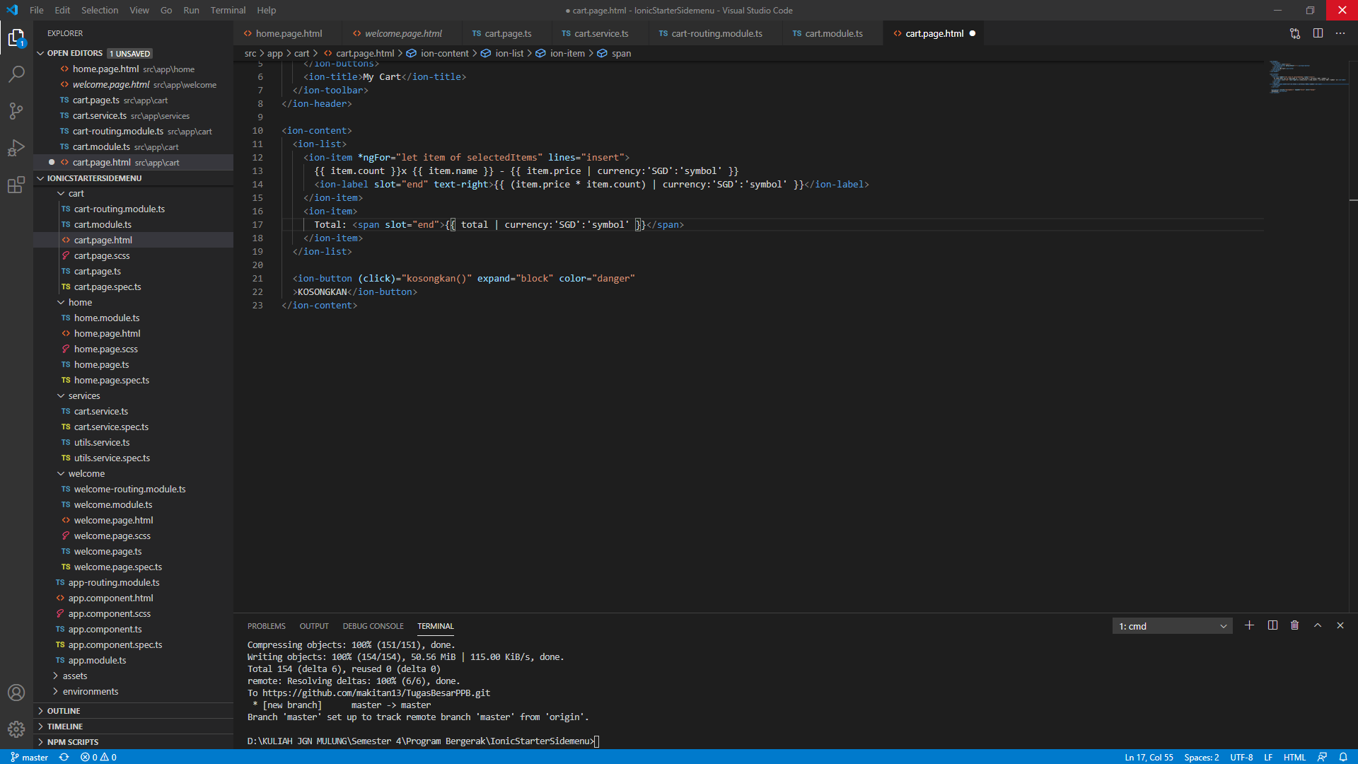
Hasil Implementasi. (Cart)

Slide 9
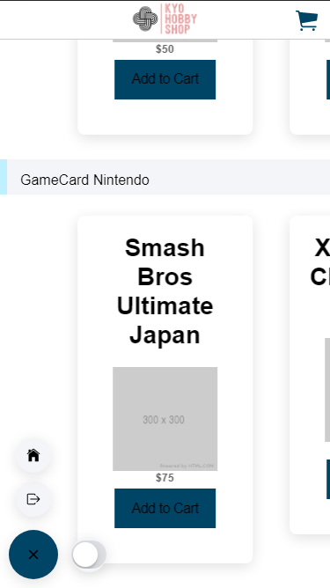
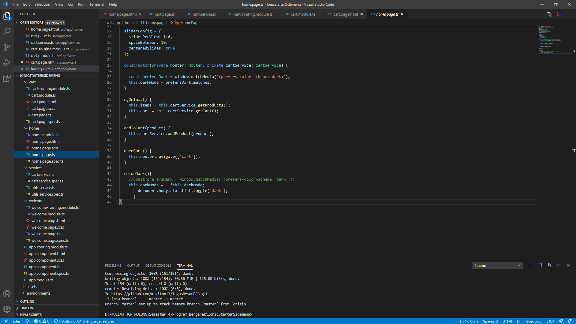
Hasil Implementasi. (Homepage)

